Slide 1

Machine Learning
ICT-
By-
Dr. Jesmin Akhter
Professor
Institute of Information Technology
Jahangirnagar University

Slide 2
Contents
The course will mainly cover the following topics:
Ensemble Learning
Unsupervised Learning
Clustering Fundamentals
Hierarchical Clustering
………………………..
Neural Networks and Deep Learning
Notes:
More Supervised - Adaboost Gradient boosting Xgboost

Slide 3
Exam schedule
Tutorial | Date and Time
Tutorial-01 | After 3 classes
Tutorial-02 | After 6 classes
Tutorial-03 | After 9 classes
NB: Schedule may change

Slide 4
Outline
Ensemble Learning
Notes:
https://iq.opengenus.org/cart-algorithm/

Slide 5
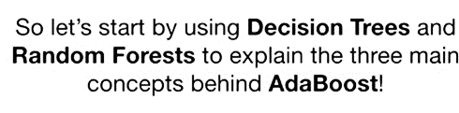
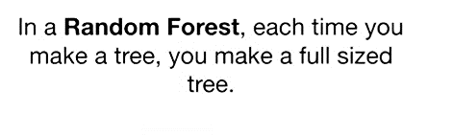
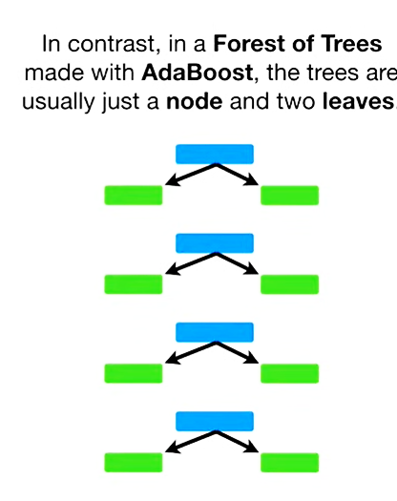
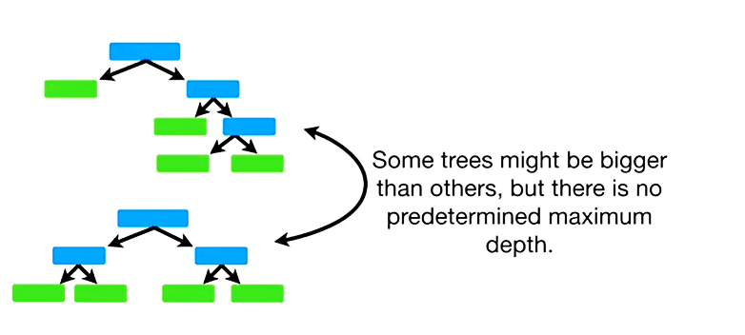

Slide 6
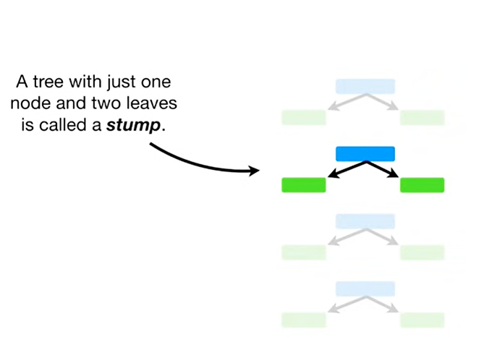
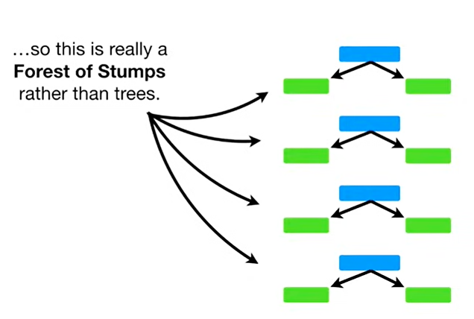
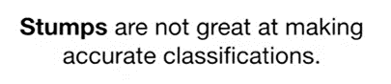

Slide 7
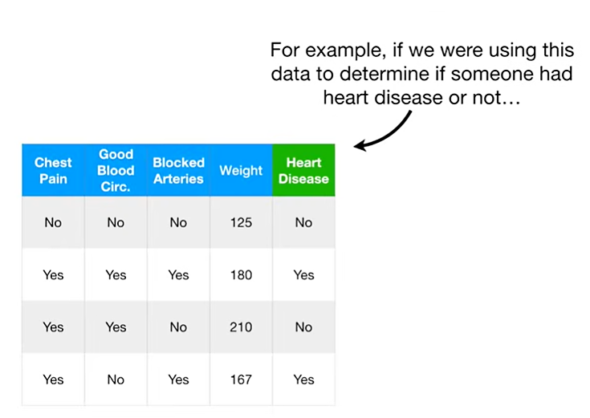

Slide 8
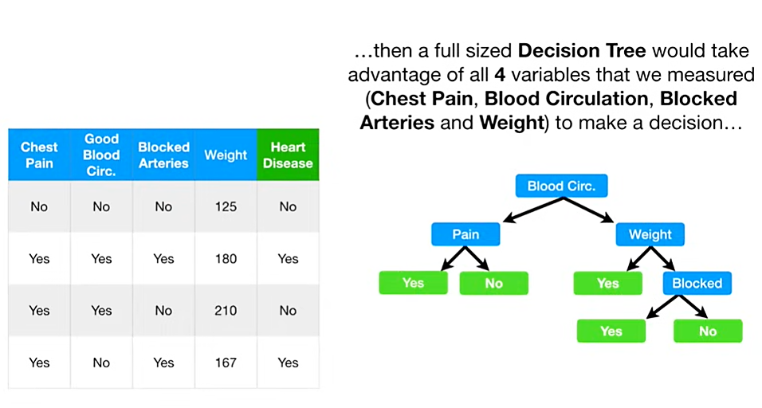

Slide 9
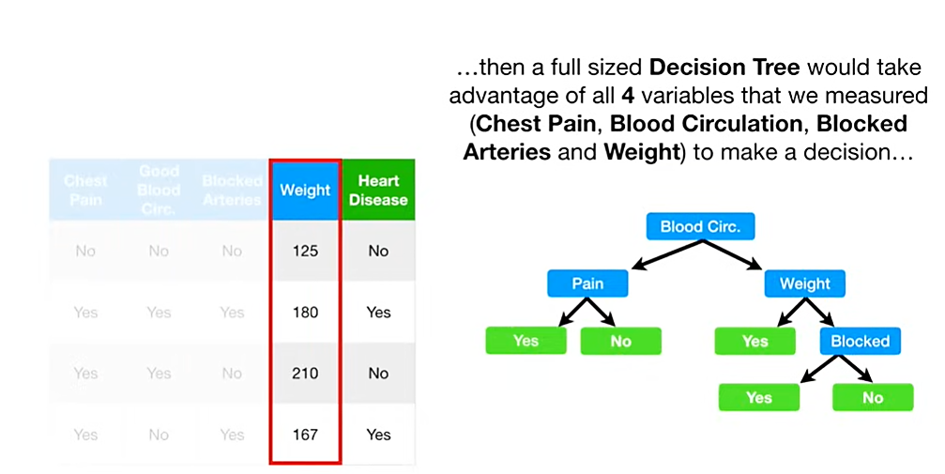
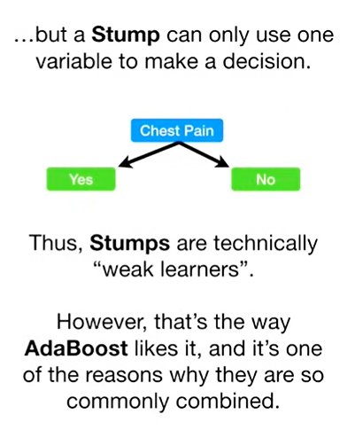
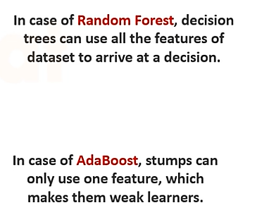

Slide 10
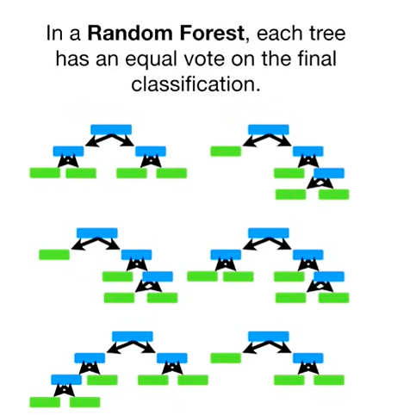
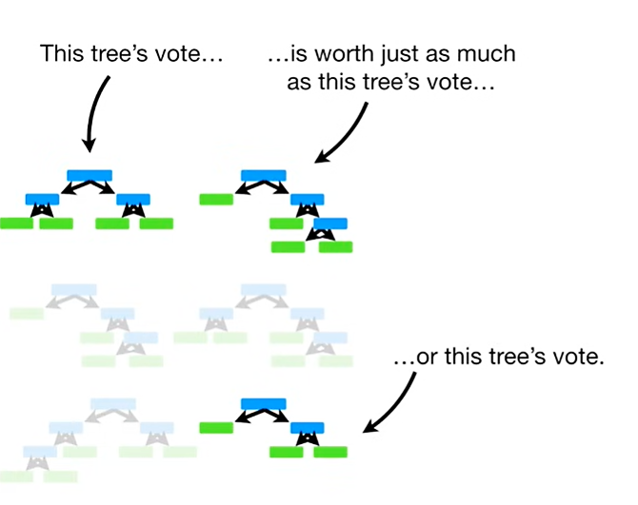

Slide 11
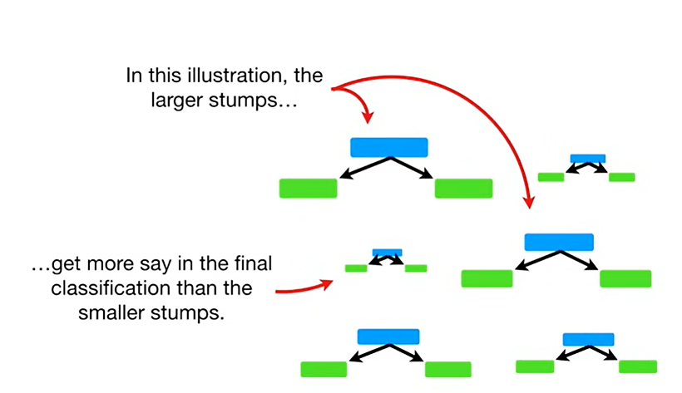
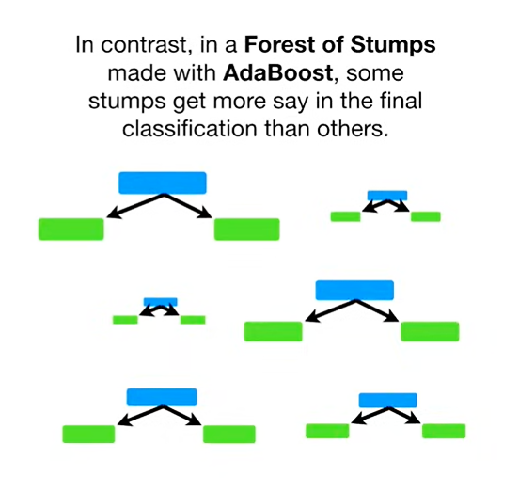

Slide 12
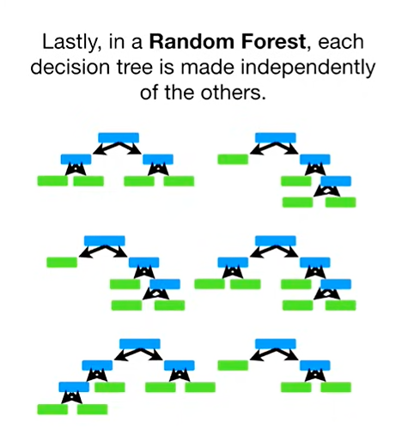

Slide 13
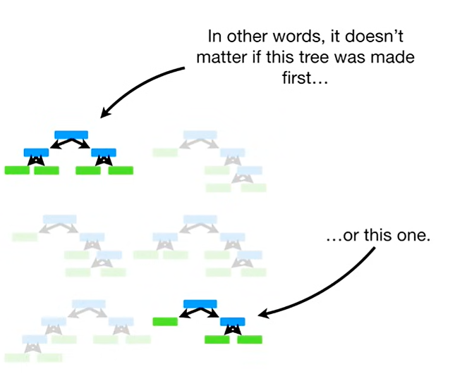
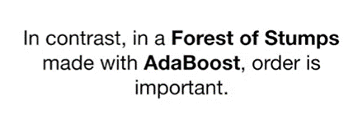
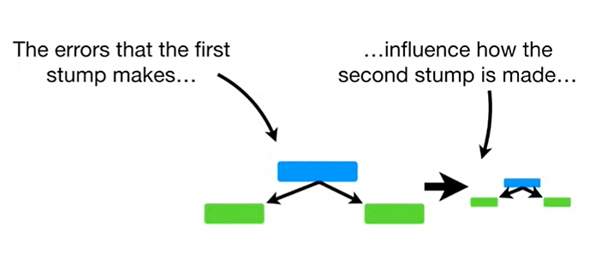
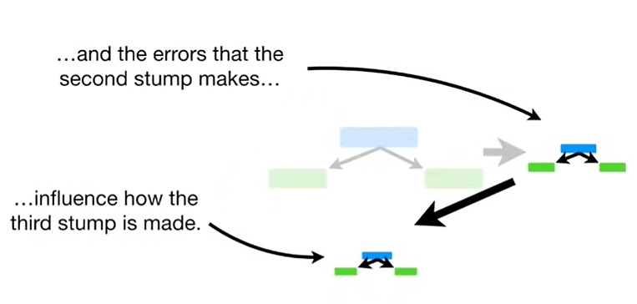
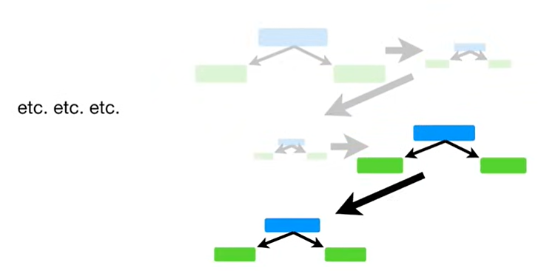

Slide 14
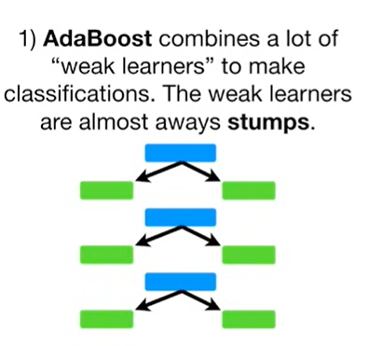
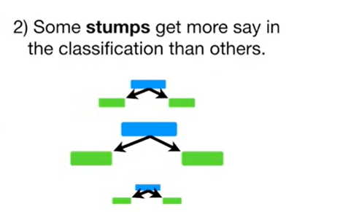
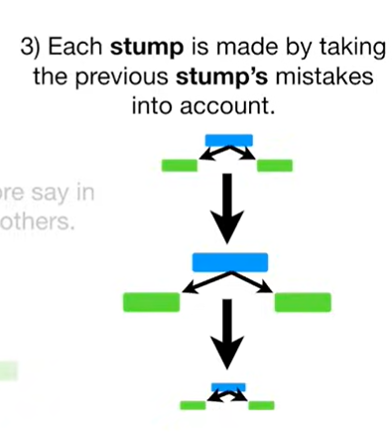

Slide 15
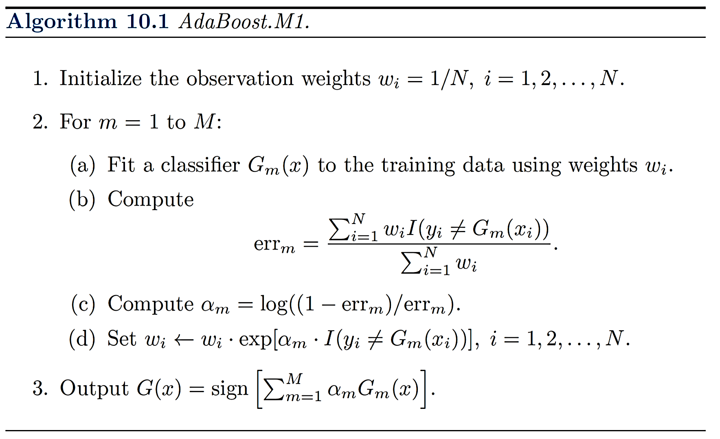
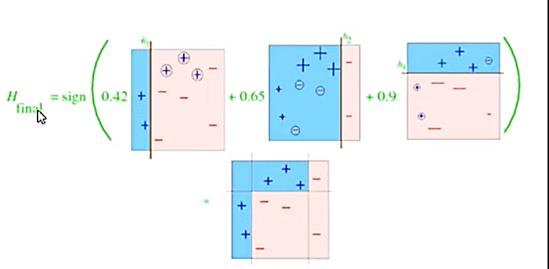

Slide 16
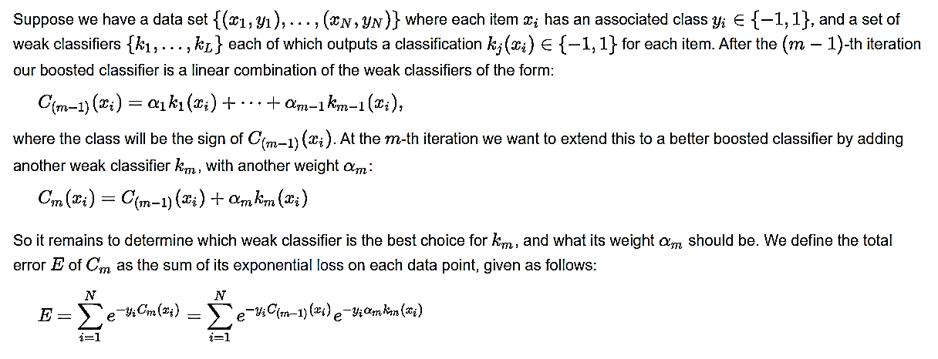

Slide 17
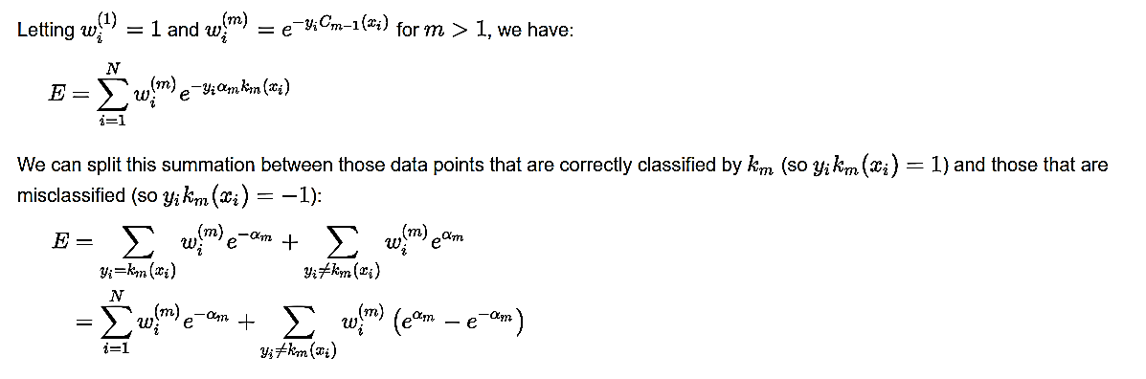

Slide 18
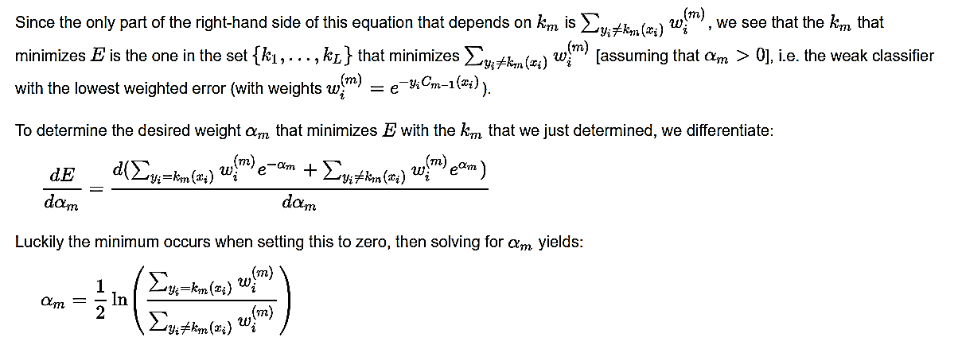
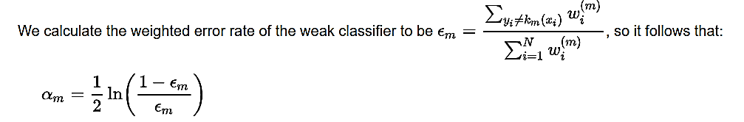

Slide 19
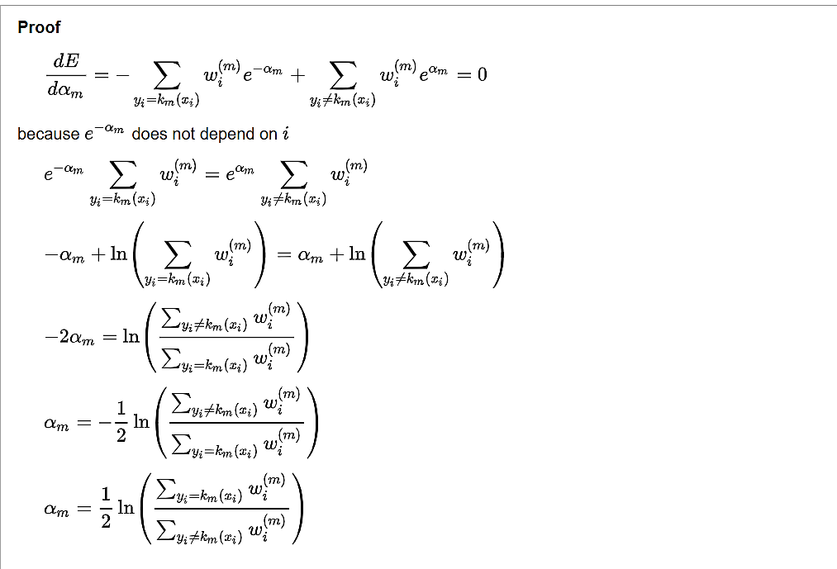
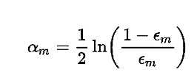

Slide 20
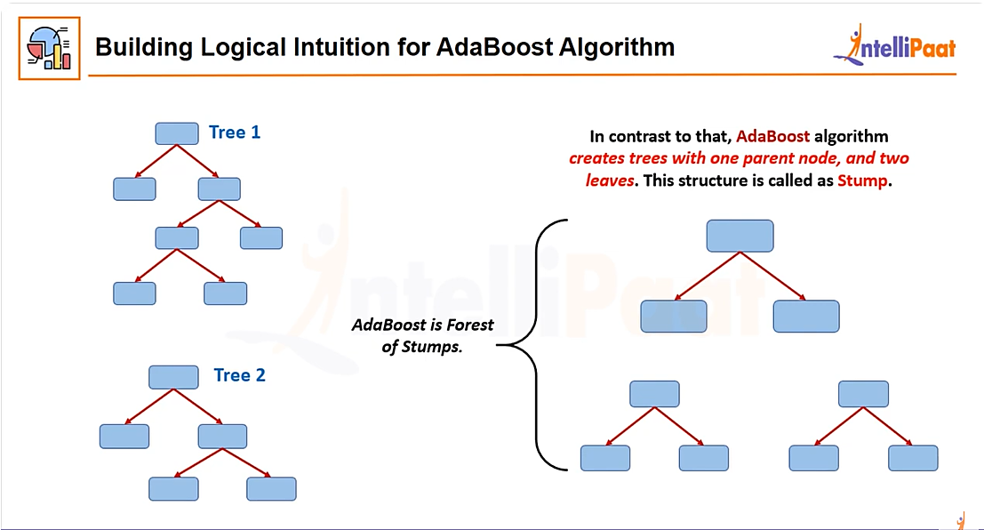

Slide 21
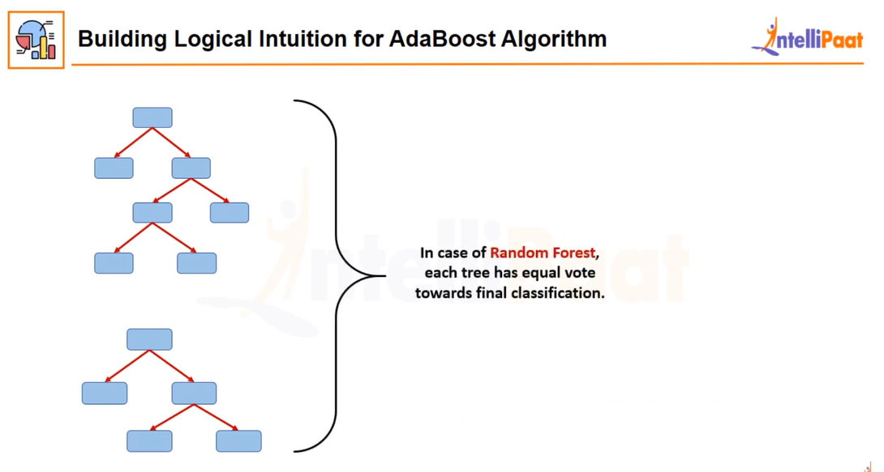

Slide 22
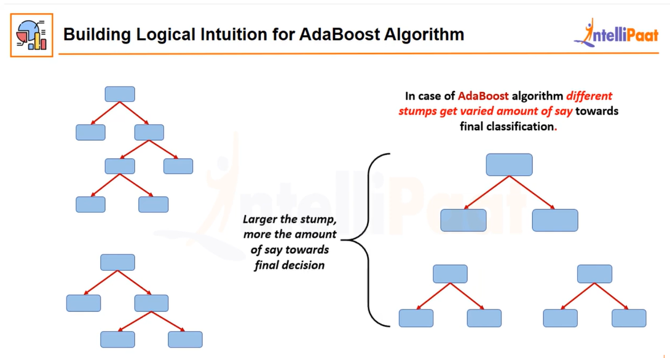

Slide 23
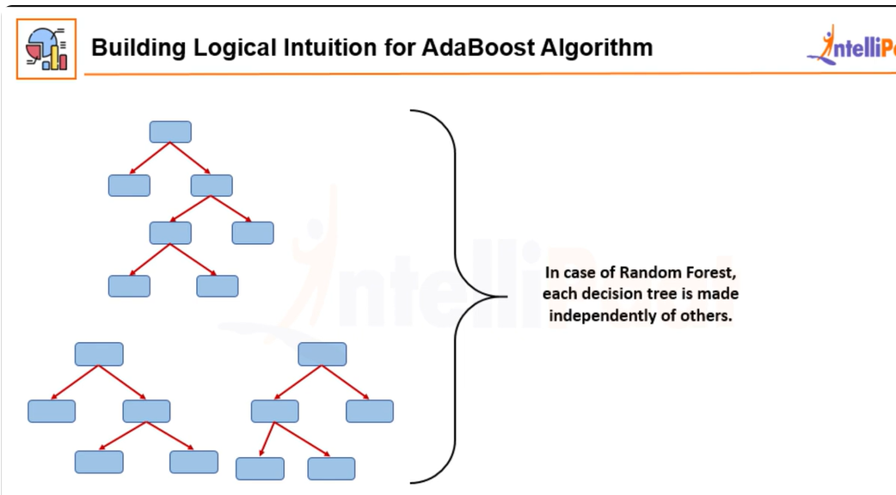

Slide 24
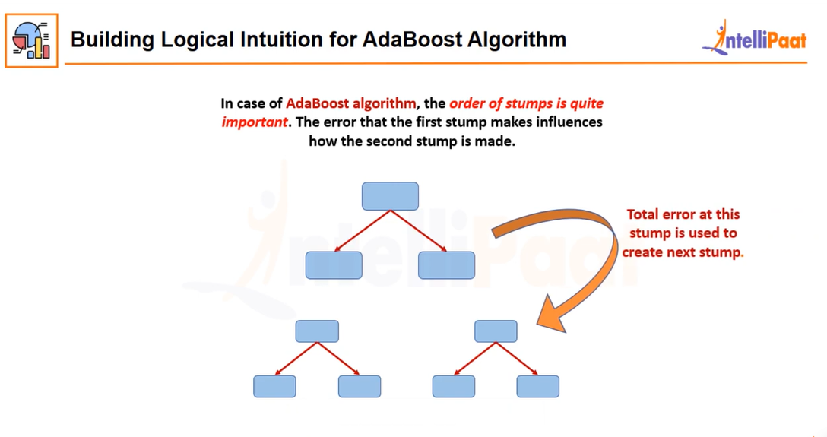

Slide 25
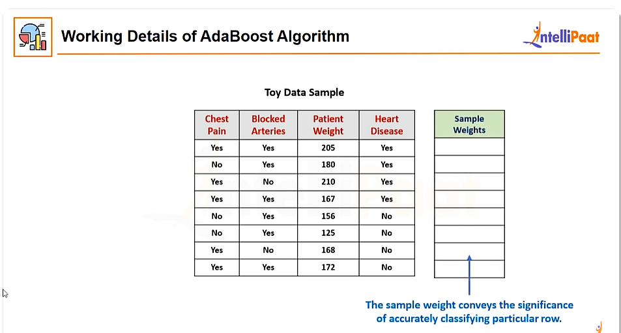
Solved Example 01

Slide 26
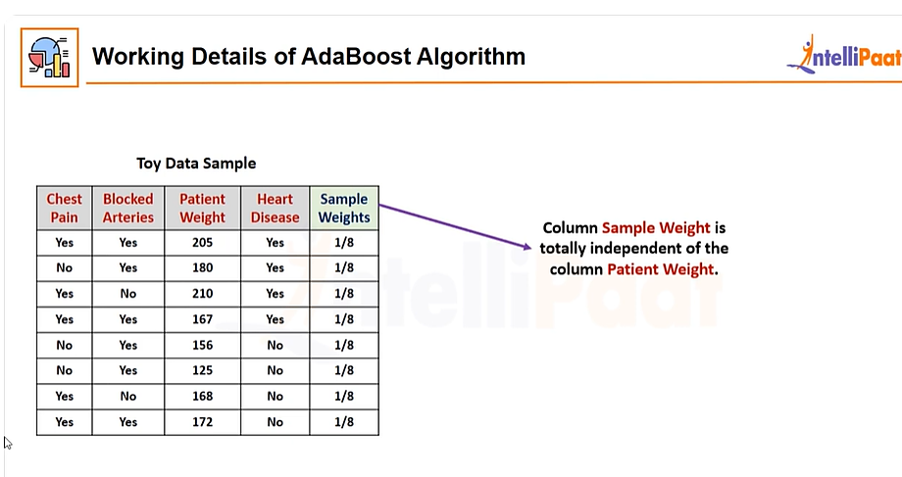

Slide 27
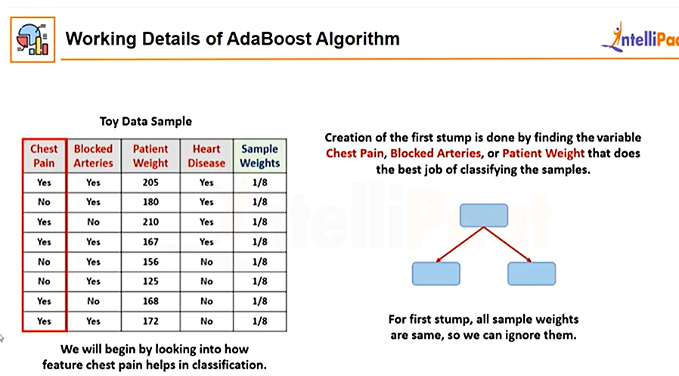

Slide 28
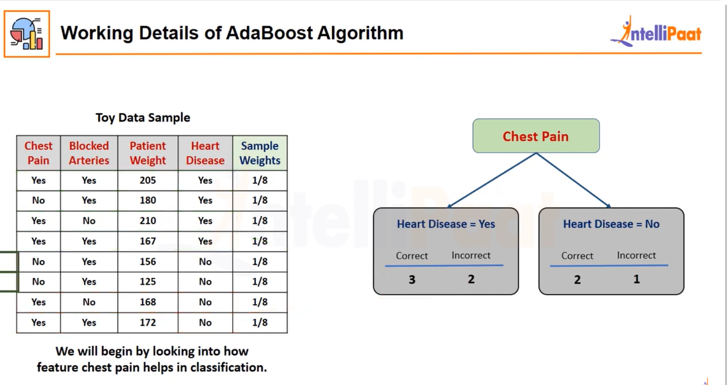

Slide 29
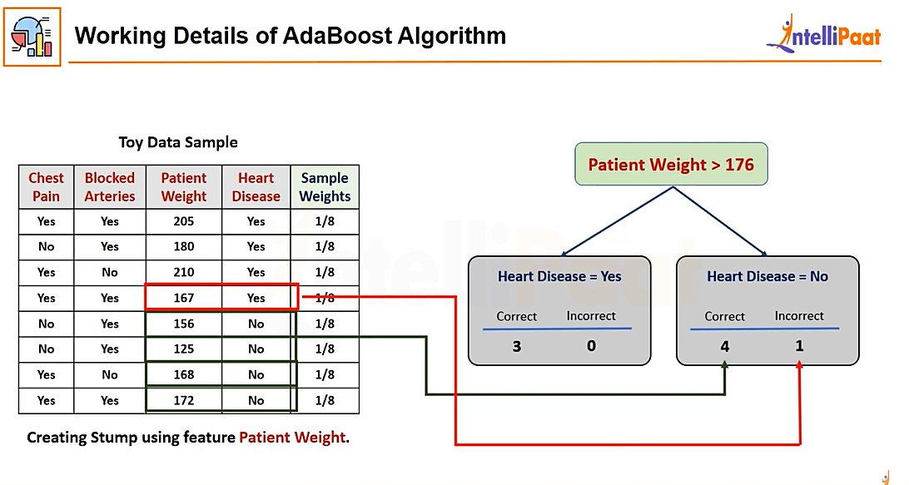

Slide 30
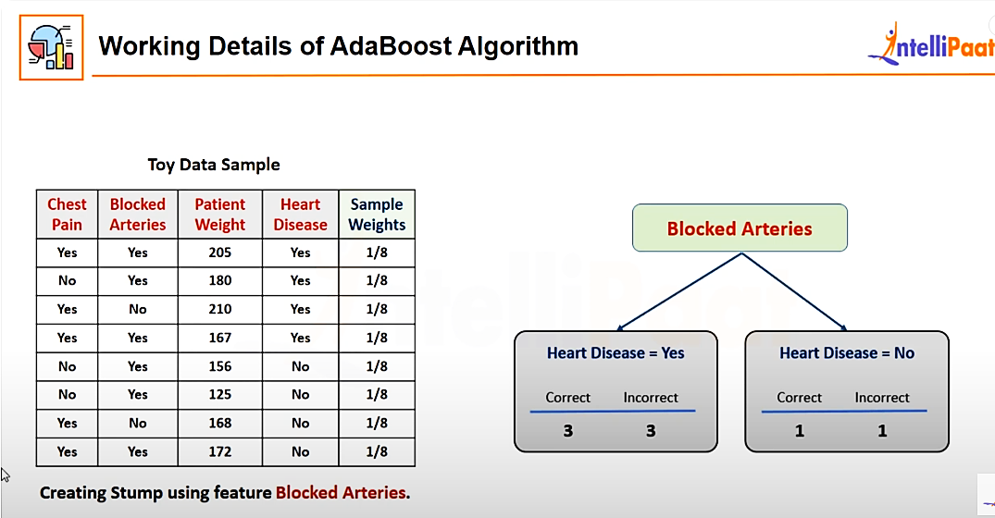

Slide 31
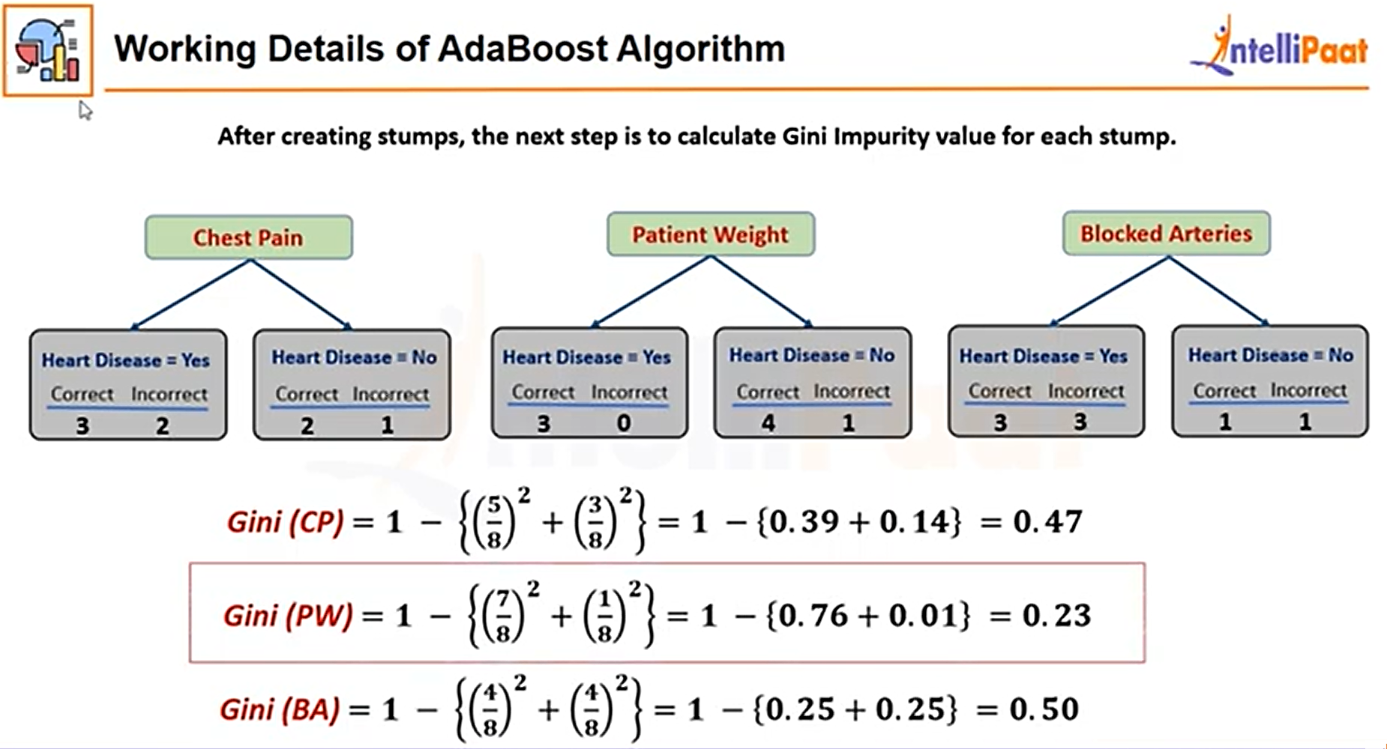

Slide 32
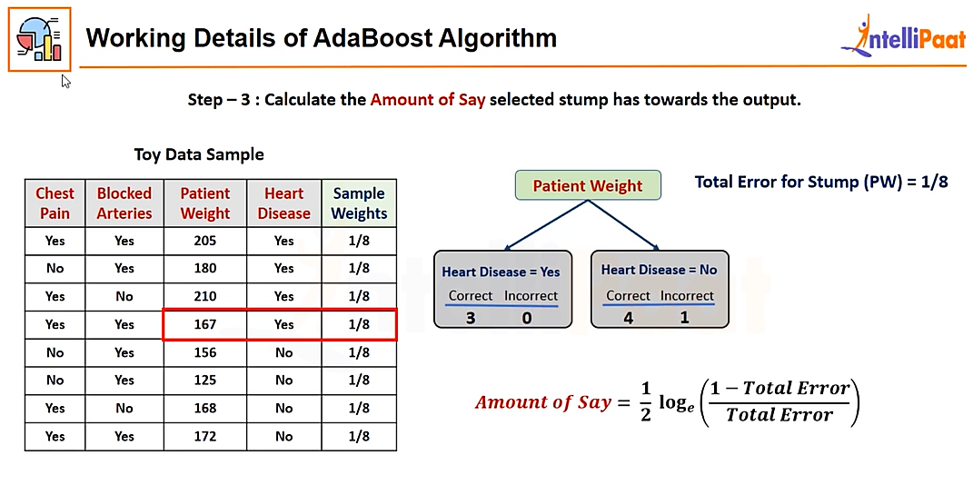

Slide 33
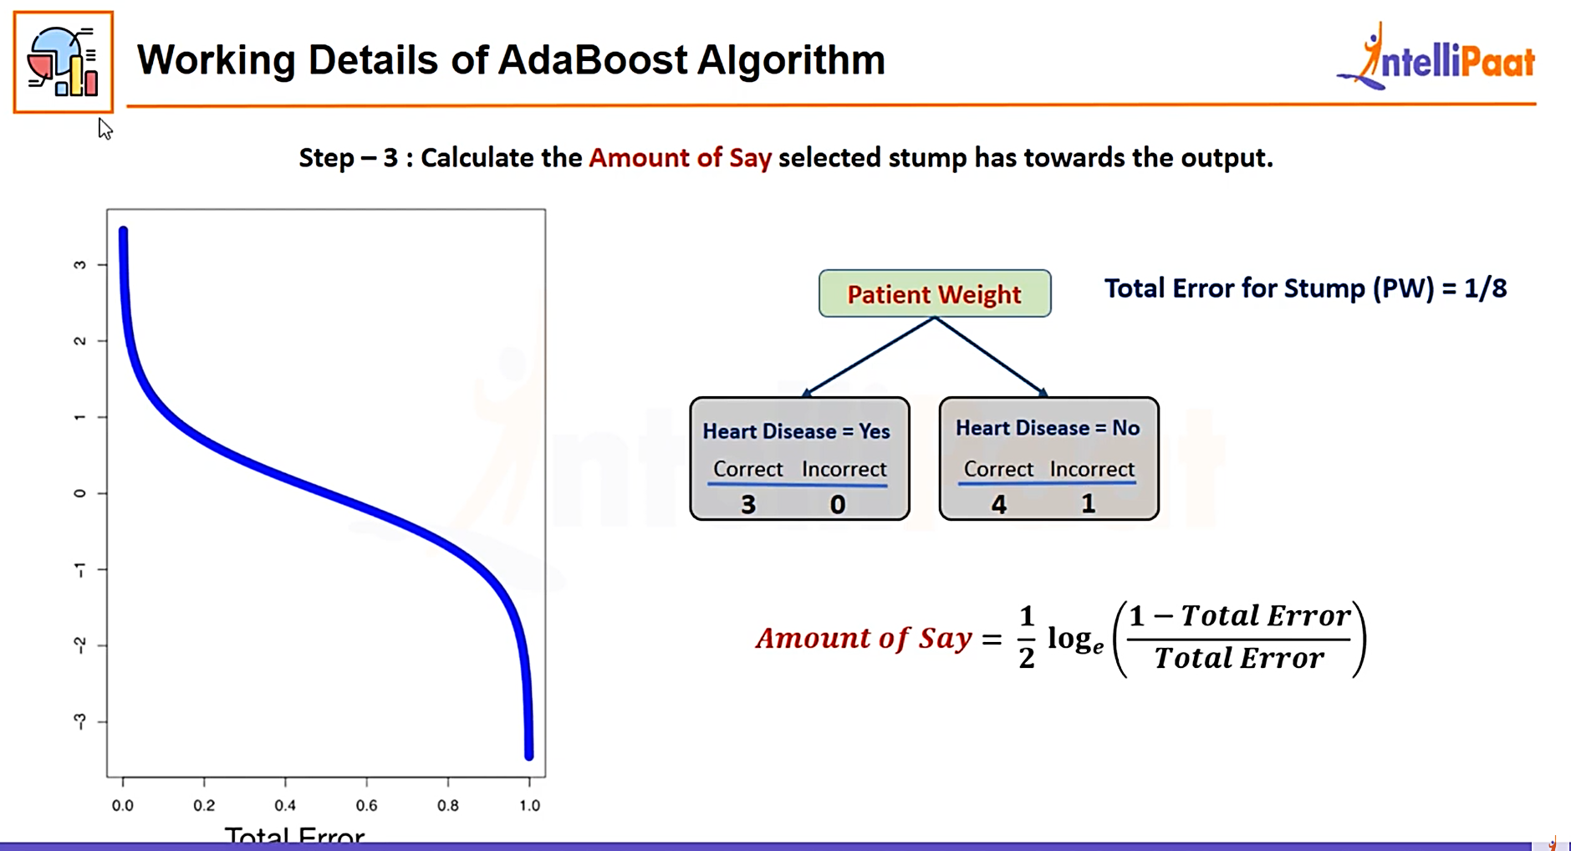

Slide 34
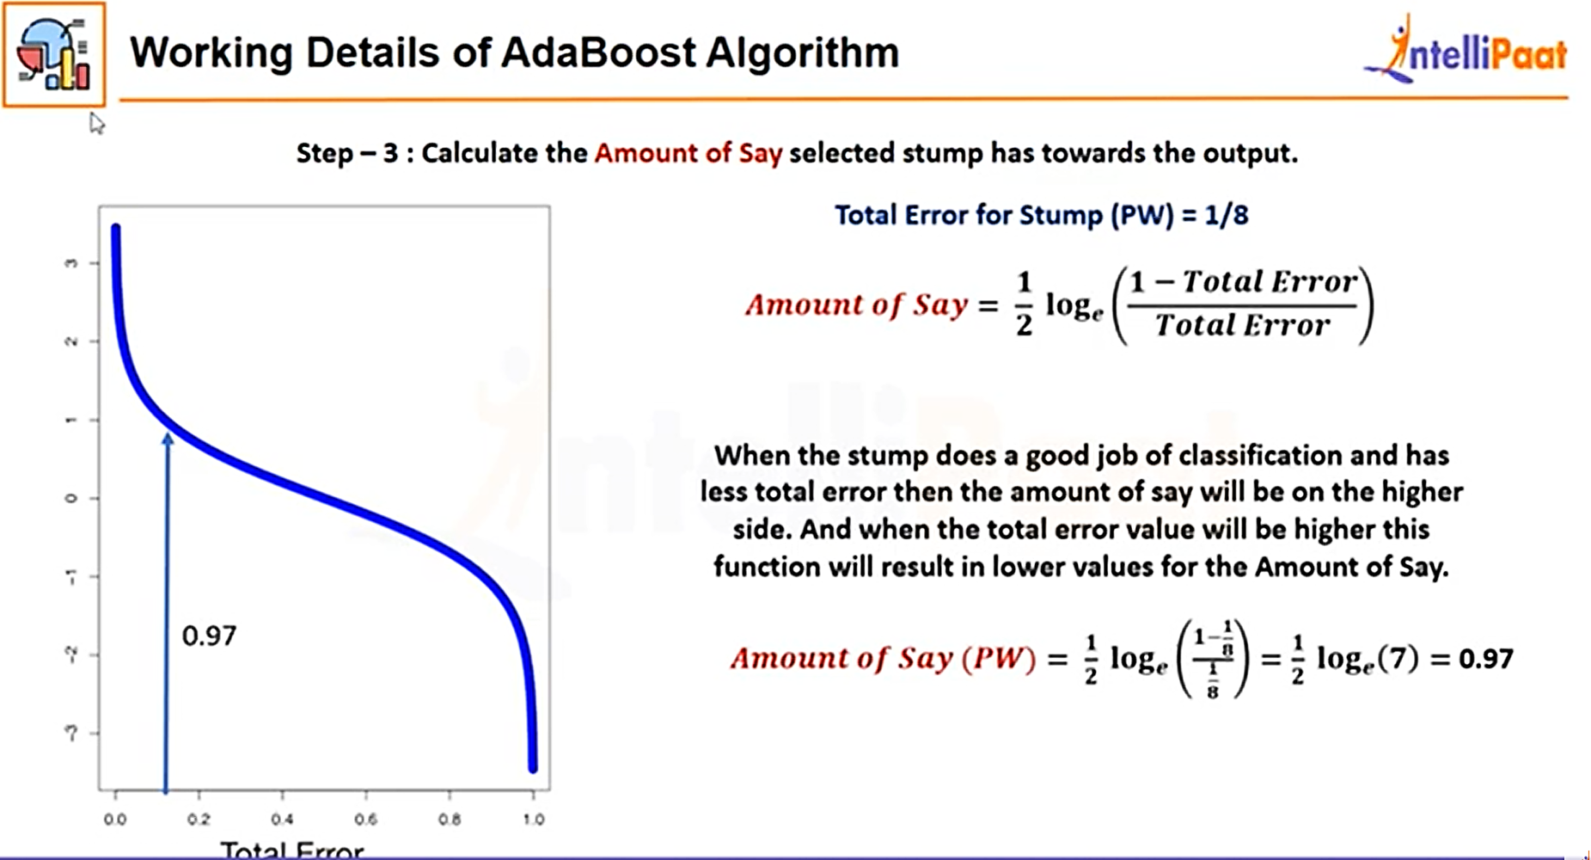

Slide 35
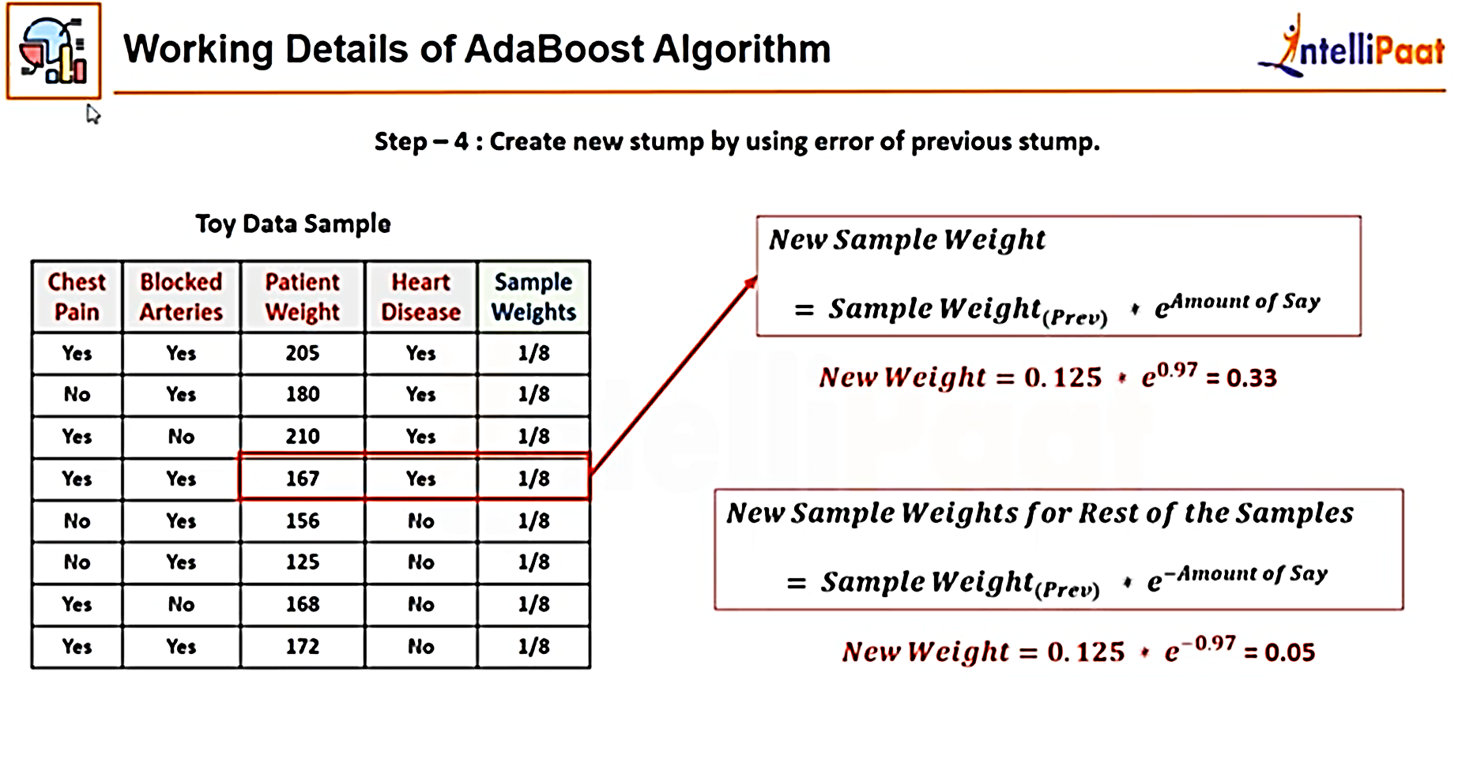

Slide 36
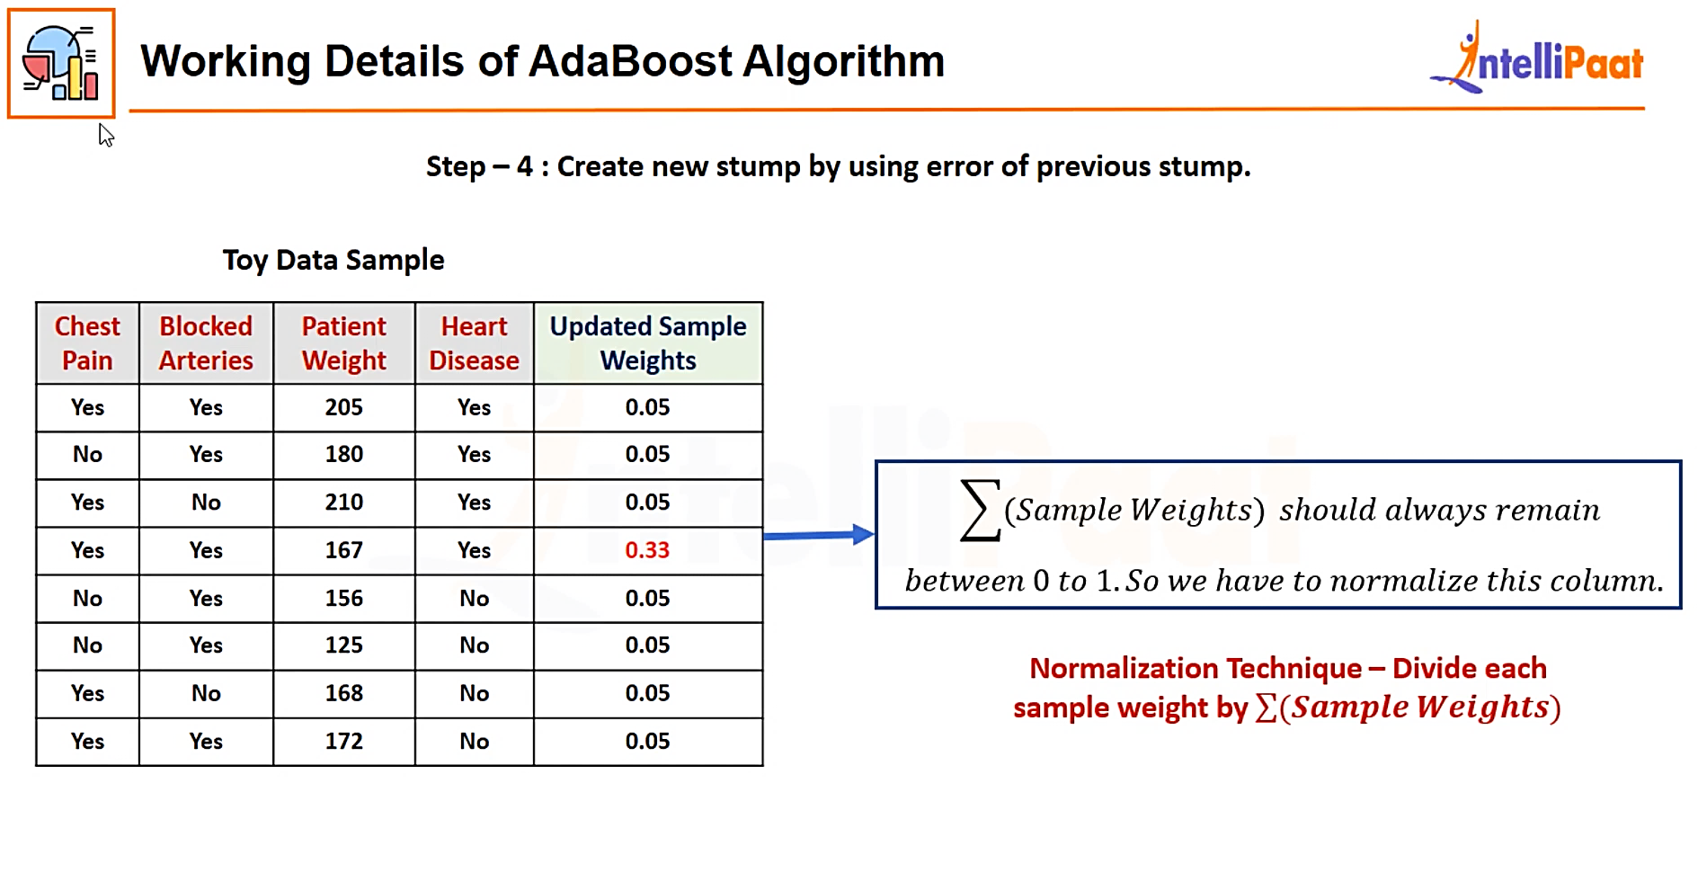

Slide 37


Slide 38

0.07 then this

Slide 39

0.07 to

Slide 40


Slide 41
Serial | Chest pain | Blocked Arteries | patient weight | Heart Disease | Predicted_Heart Disease | sample weight | updated | normalized | Lower | Upper
1 | y | y | 205 | y |  | 0.13 | 0.04738538 | 0.071639648 | 0 | 0.07164
2 | n | y | 180 | y |  | 0.13 | 0.04738538 | 0.071639648 | 0.07164 | 0.143279
3 | y | n | 210 | y |  | 0.13 | 0.04738538 | 0.071639648 | 0.143279 | 0.214919
4 | y | y | 167 | y | misclassification | 0.13 | 0.329743057 | 0.498522467 | 0.214919 | 0.713441
5 | n | y | 156 | n |  | 0.13 | 0.04738538 | 0.071639648 | 0.713441 | 0.785081
6 | n | y | 125 | n |  | 0.13 | 0.04738538 | 0.071639648 | 0.785081 | 0.856721
7 | y | n | 168 | n |  | 0.13 | 0.04738538 | 0.071639648 | 0.856721 | 0.92836
8 | y | y | 172 | n |  | 0.13 | 0.04738538 | 0.071639648 | 0.92836 | 1
 |  |  | misclassification=1 |  |  | Sum= | 0.661440716
 |  |  | patient weight>176
 |  |  | error=1/8
Take random number: 0.72 0.42 0.51 0.83 etc and got the next slide records

Slide 42


Slide 43


Slide 44


Slide 45

Notes:
https://www.youtube.com/watch?v=56XQCOPkXNg&t=1174s

Slide 46
Boosting vs Bagging
Boosting | Bagging
boosting works better for stable models like linear regression | Bagging can be used with unstable models like decision trees
boosting reduces bias | Bagging reduces variance
At every successive layer Models are weighted according to their performance. | All the models have the same weightage
New Models are influenced by the accuracy of previous Models | All the models are independent of each other
Works best with models that have low variance but high bias | Works best with models that have high variance but low bias

Slide 47
Thank You

